Slide 1

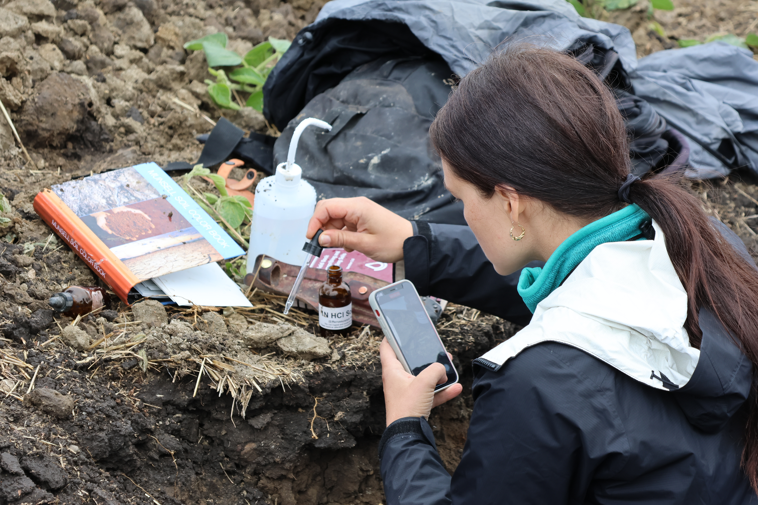
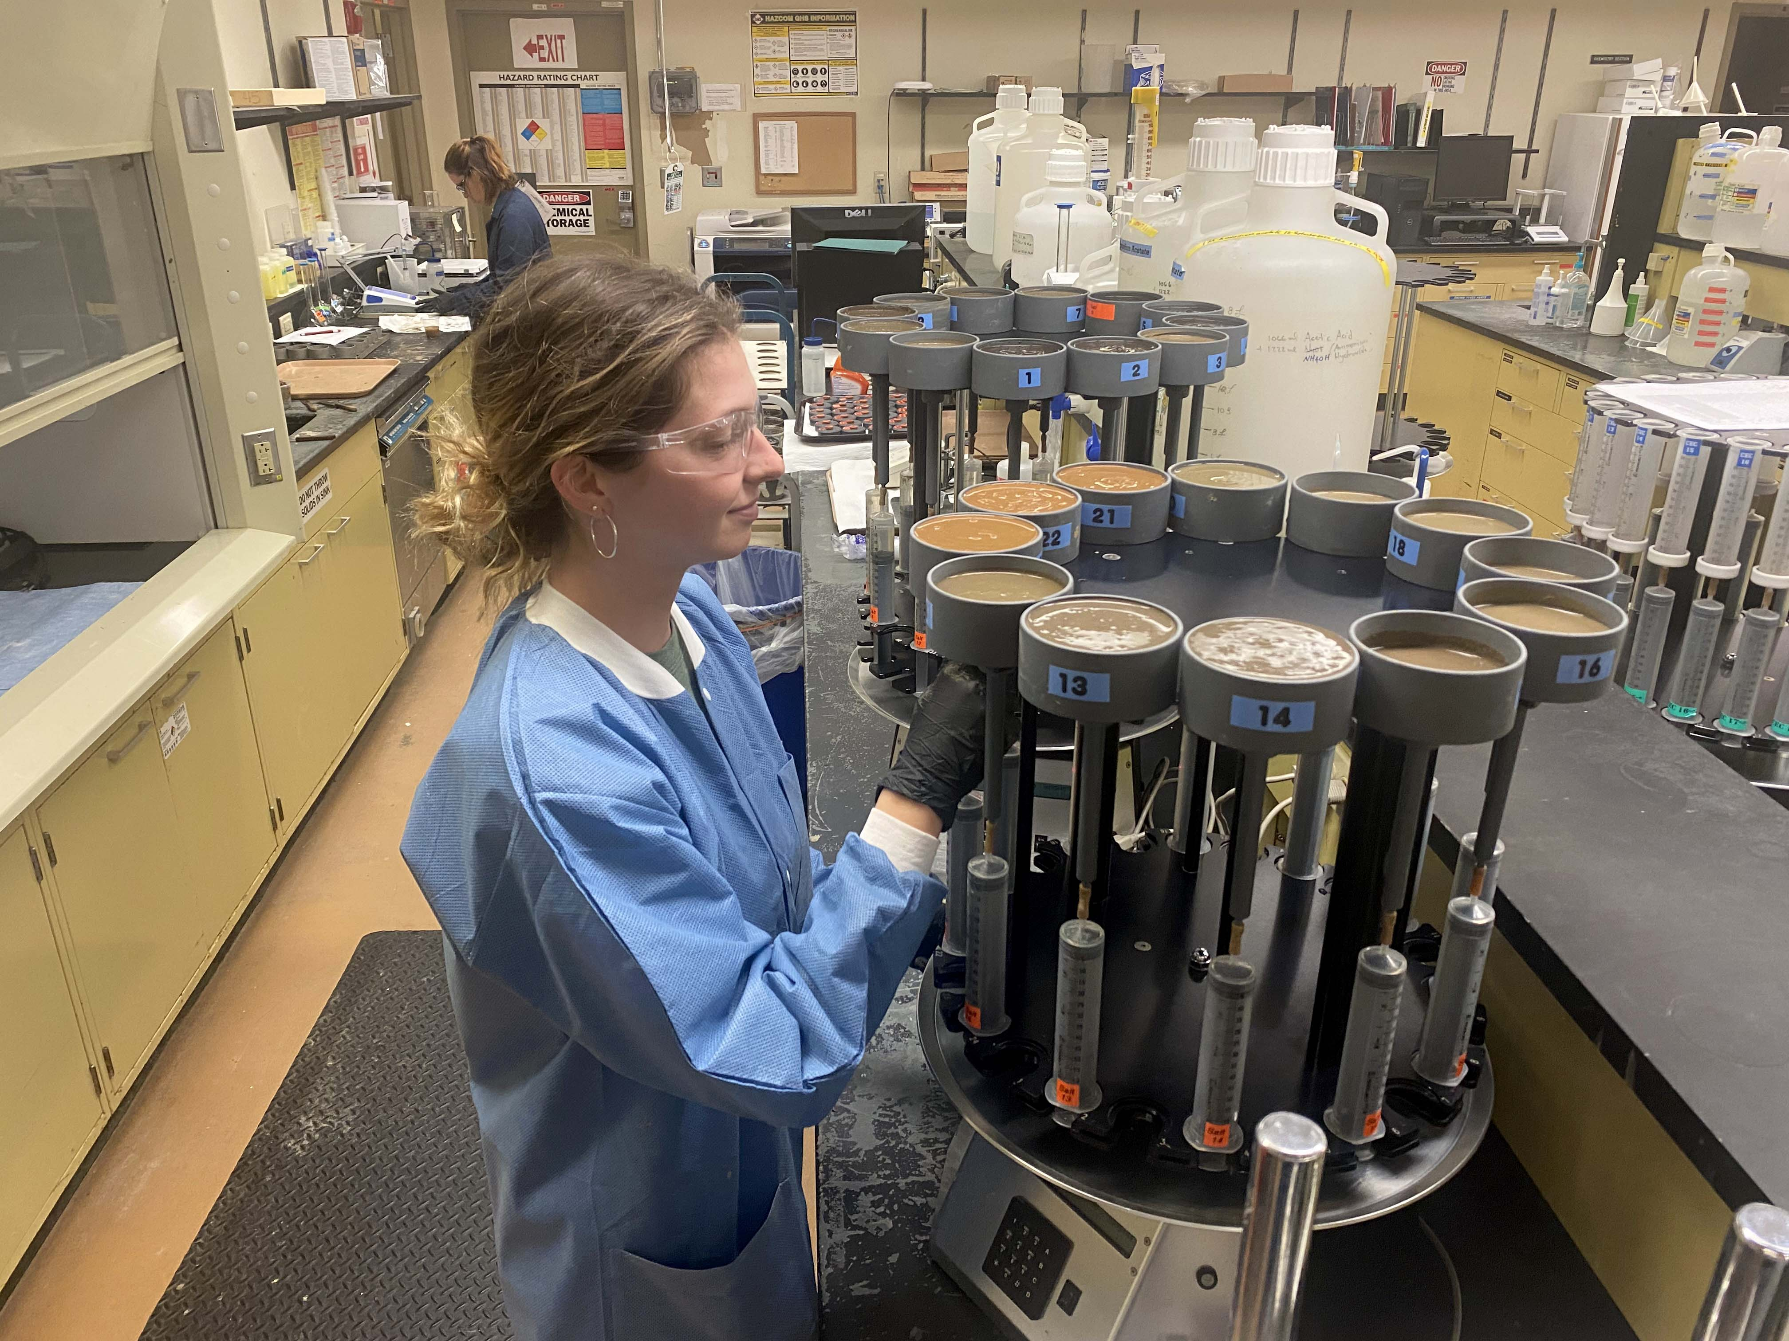

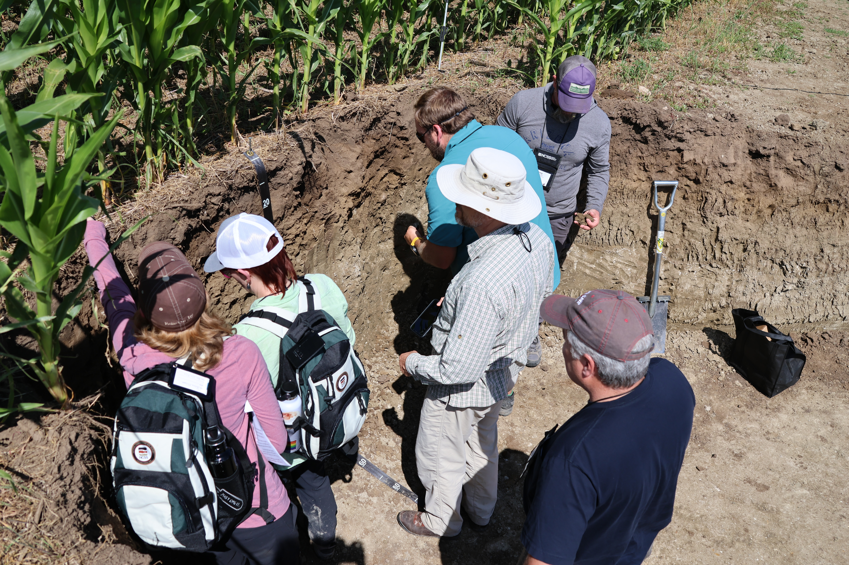
Data Analysis

Slide 2
Objectives
Map Unit / Polygon (Weighted average, Dominant condition)
Component (%)
Component (%)
Horizons (L, RV, H)
Horizons (L, RV, H)
Estimate component range in characteristics (RIC)
Review methods for estimating Low, RV, and High values
Review different methods for visualizing soil data
Soil Reports
Estimate map unit composition (i.e. weights)
Sampling
“Modeling”
Estimate map unit aggregations
Weighted average
Dominant condition

Slide 3
Range in Characteristics (RIC)
Why does the L, RV, and H clay represent?
What taxonomic unit do they refer too?
What is the L and H for texture?

Slide 4
Summary Statistics - Estimates of L, RV, H
hzname | clay_l | clay_r | clay_h | texture
Ap | 10 | 18.0 | 24 | sil
BE | 10 | 17.0 | 24 | sil
Bt1 | 20 | 25.0 | 26 | sil
2Bt2 | 35 | 40.0 | 45 | sic
2BCt | 12 | 26.0 | 35 | l
2Cd | 10 | 17.5 | 25 | l

Slide 5
Summary Statistics - Estimates of L, RV, H
Parameter | NASIS | Description | R function
Mean | RV | arithmetic average | mean() weighted.mean()
Median | RV | middle value, 50% quantile | median() DescTools::Median()
Mode | RV | most frequent value | table() |> sort(d = TRUE)[1] xtabs(weights ~) DescTools::Mode()
Standard Deviation | L & H | variation | sd() DescTools::SD()
Quantiles | L & H | percent rank of values, such that all values are <= p | quantile() DescTools::Quantile()

Slide 6
Descriptive Statistics - Numeric Data
data("loafercreek") h <- horizons(loafercreek) h$texture_class <- factor(h$texture_class) h %>% select(clay, phfield, total_frags_pct, texture_class) %>% summary()
## clay phfield total_frags_pct texture_class ## Min. :10.00 Min. :4.90 Min. : 0.00 l :265 ## 1st Qu.:18.00 1st Qu.:6.00 1st Qu.: 0.00 br :105 ## Median :22.00 Median :6.30 Median : 5.00 cl :101 ## Mean :23.63 Mean :6.18 Mean :13.88 sil : 56 ## 3rd Qu.:28.00 3rd Qu.:6.50 3rd Qu.:20.00 spm : 22 ## Max. :60.00 Max. :7.00 Max. :95.00 (Other): 52 ## NA's :167 NA's :381 NA's : 25

Slide 7
Categorical Data
table(h$genhz, h$texture_class, useNA = "ifany")
## br c cb cl gr l pg scl sic sicl sil sl spm <NA> ## 2BCt 0 6 0 3 0 0 0 0 0 0 0 0 0 0 ## 2Bt 0 5 0 1 0 0 0 0 0 0 0 0 0 0 ## A 0 0 0 1 0 97 0 0 0 1 29 7 0 3 ## BA 0 0 0 0 0 2 0 0 0 0 0 0 0 0 ## BCt 0 2 0 8 0 7 0 1 0 1 1 0 0 1 ## Bt 0 0 0 17 0 37 0 0 0 0 1 1 0 0 ## Bt1 0 1 0 13 0 57 0 3 0 1 12 0 0 2 ## Bt2 0 4 0 40 0 45 0 4 2 6 8 0 0 0 ## Bt3 0 0 0 6 0 2 0 0 0 0 0 0 0 0 ## Cr 55 1 1 1 3 1 1 1 0 0 0 0 0 10 ## R 43 0 0 0 0 0 0 0 0 0 0 0 0 2 ## <NA> 7 0 0 11 0 17 0 0 0 0 5 0 18 7

Slide 8
Data Inspection - Missing Data
Exclude all rows or columns that contain missing values using the function na.exclude(), such as h2 <- na.exclude(h). However this can be wasteful because it removes all rows (e.g., horizons), regardless if the row only has 1 missing value. Instead it’s sometimes best to create a temporary copy of the variable in question and then remove the missing variables, such as clay <- na.exclude(h$clay).
Replace missing values with another value, such as zero, a global constant, or the mean or median value for that column, such as h$clay <- ifelse(is.na(h$clay), 0, h$clay) # or h[is.na(h$clay), ] <- 0.
Read the help file for the function you’re attempting to use. Many functions have additional arguments for dealing with missing values, such as na.rm.

Slide 9
Graphical Methods - Descriptions
Plot Types | Description
Bar | a plot where each bar represents the frequency of observations for a ‘group’
Histogram | a plot where each bar represents the frequency of observations for a ‘given range of values’
Density | an estimation of the frequency distribution based on the sample data
Quantile-Quantile | a plot of the actual data values against a normal distribution
Box-Whisker | a visual representation of median, quartiles, symmetry, skewness, and outliers
Scatter & Line | a graphical display of one variable plotted on the x axis and another on the y axis

Slide 10
Graphical Methods - Functions
Plot Types | Base R | lattice | ggplot geoms
Bar | barplot() | barchart() | geom_bar()
Histogram | hist() | histogram() | geom_histogram()
Density | plot(density()) | densityplot() | geom_density()
Quantile-Quantile | qqnorm() | qq() | geom_qq()
Box-Whisker | boxplot() | bwplot() | geom_boxplot()
Scatter & Line | plot() | xyplot | geom_point()

Slide 11
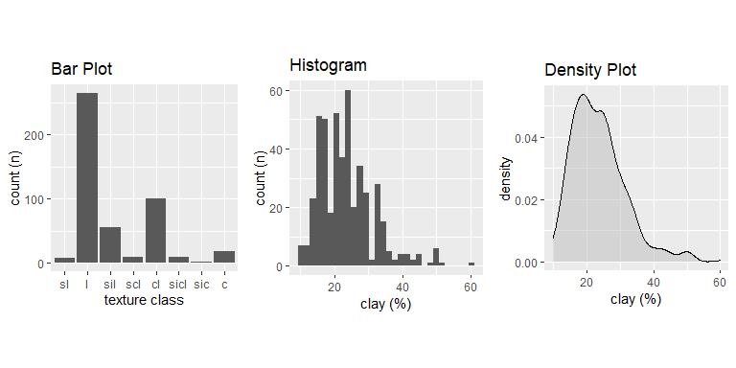
Distributions

Slide 12
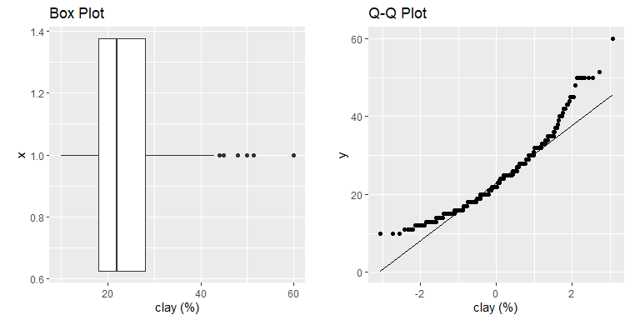
Distributions

Slide 13
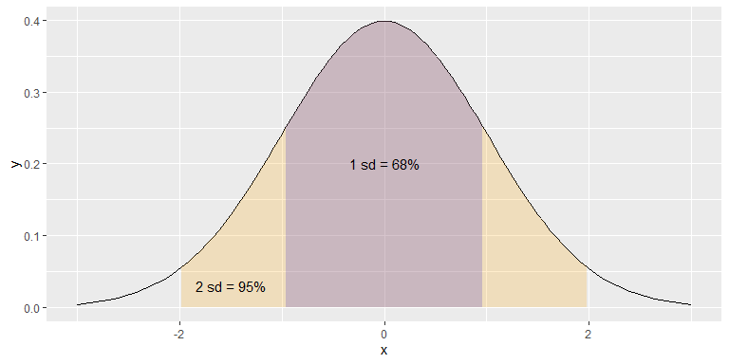
The ‘Normal’ Distribution

Slide 14
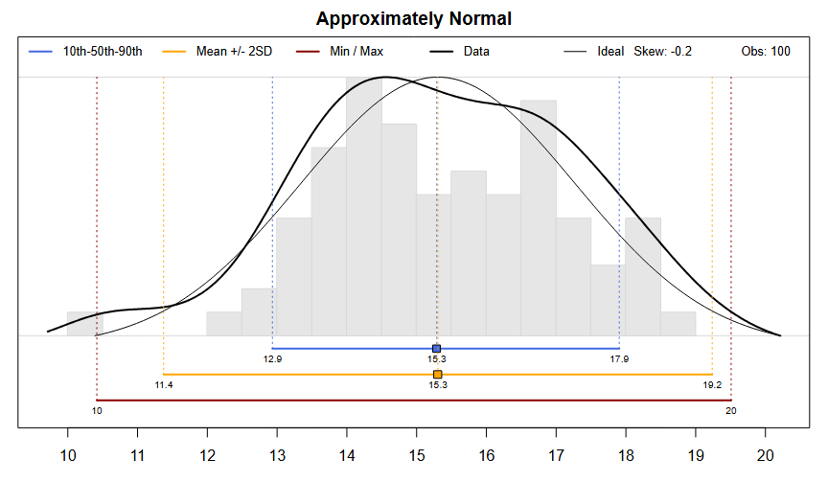
Mean & SD vs Median & Quantiles

Slide 15
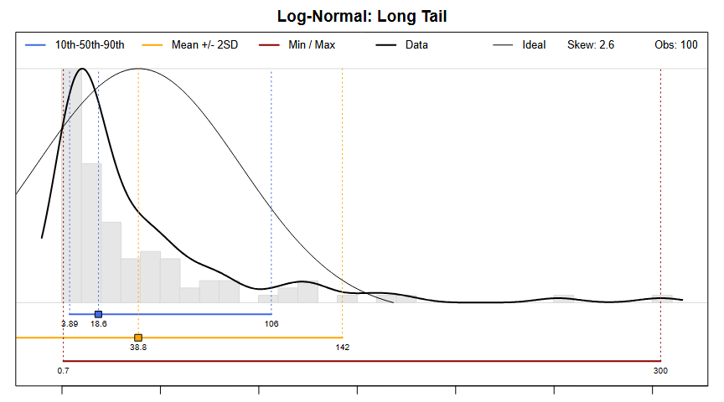
Mean & SD vs Median & Quantiles

Slide 16
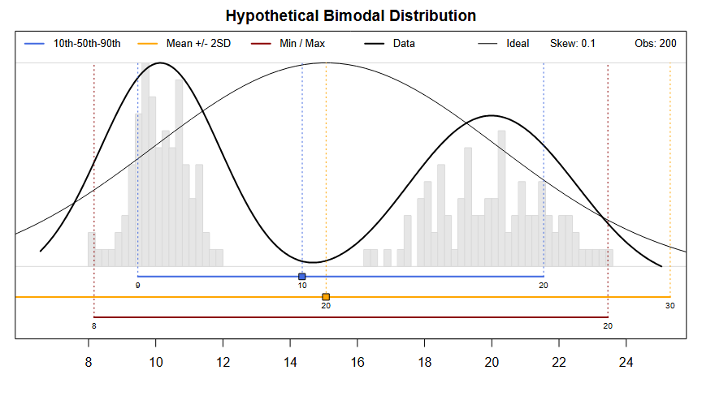
Mean & SD vs Median & Quantiles

Slide 17
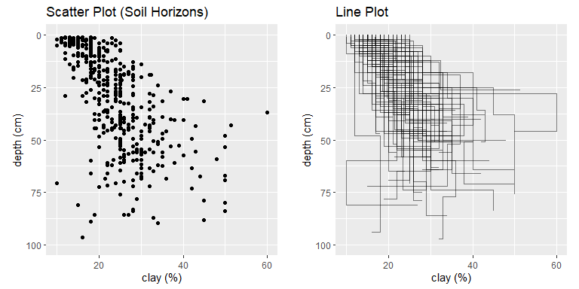
Relationships

Slide 18
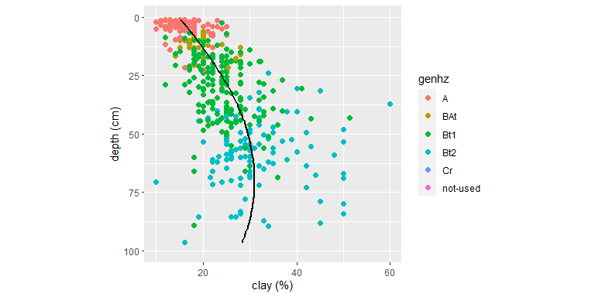
3rd Dimension - Color, Shape, Size, Layers, etc…

Slide 19
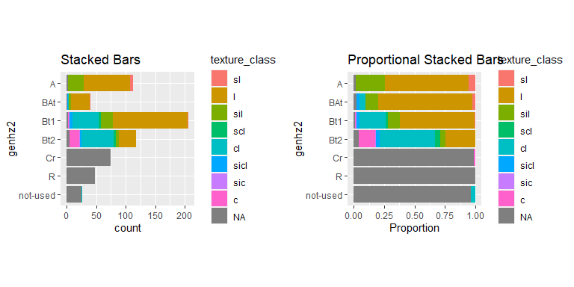
3rd Dimension - Color

Slide 20
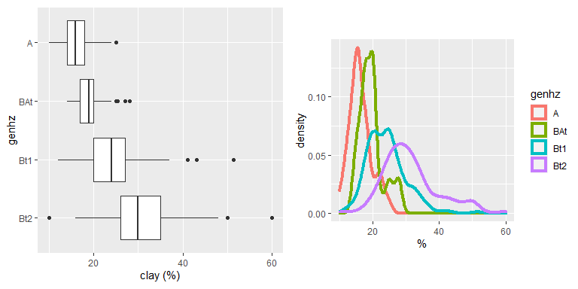
3rd Dimension - Groups

Slide 21
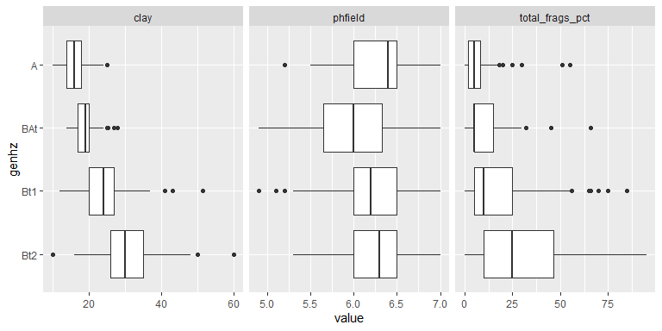
3rd Dimension - Facets

Slide 22
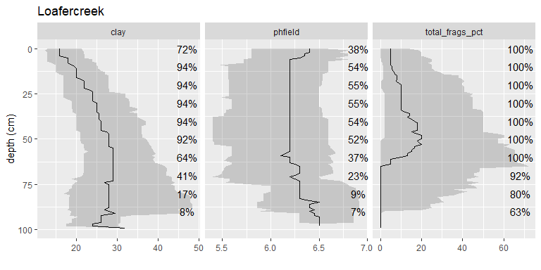
3rd Dimension - Facets
Notes:
Depth slices are self weighting.

Slide 23
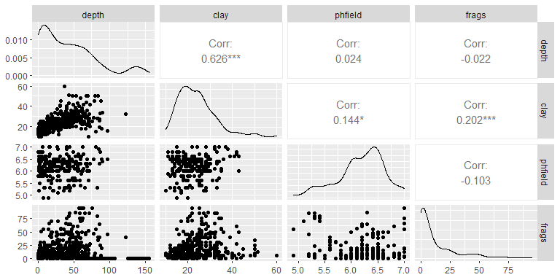
3rd Dimension - Correlation

Slide 24
ggplot2 basics
h <- horizons(loafercreek) # set figure axis and aesthetics p <- ggplot(data = h, aes(x = clay, y = hzdept, color = genhz)) # add layers p + geom_point()

Slide 25
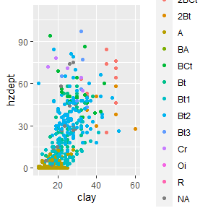

Slide 26
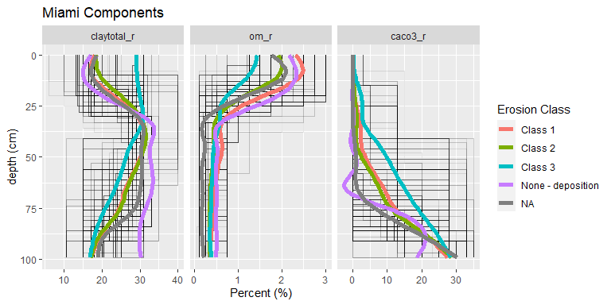
Summary of Component Phases

Slide 27


Map Unit Composition
Polygon
Pixel
B = 70%
B = 70%
A = 30 %
A = 30 %
 | Component
Map Unit | A | B | User Accuracy / Map Unit Purity
B-A | 30 | 70 | 70
B | 90 | 10 | 90

Slide 28
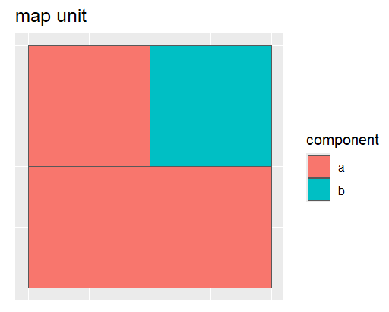
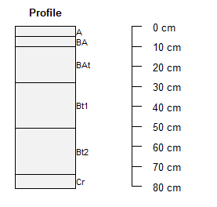
Weighting
Weight = Thickness
Weight = Component Acres

Slide 29
What is a weight?
A weight (w) is the number of observations a sample (n) represents within a population (N).
w = N / n
N = sum(w)
Inflation
100 / 10 = 10
each 1 sample represents 10 units within the population
Dilution
10 / 30 = 0.33
each 1 sample represents 0.33 units within the population

Slide 30
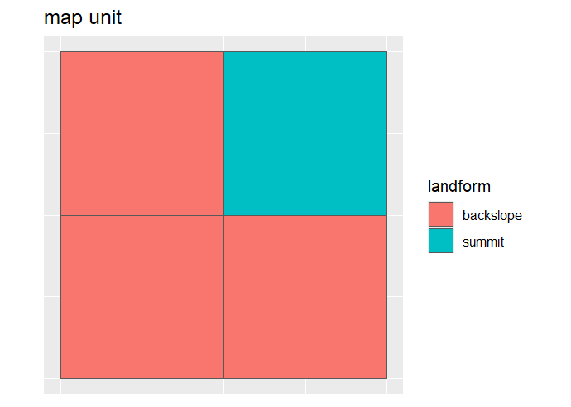
Map Unit Composition
Estimate map unit composition
Sampling (e.g. transecting)
“Modeling” (e.g. zonal statistics)

Slide 31
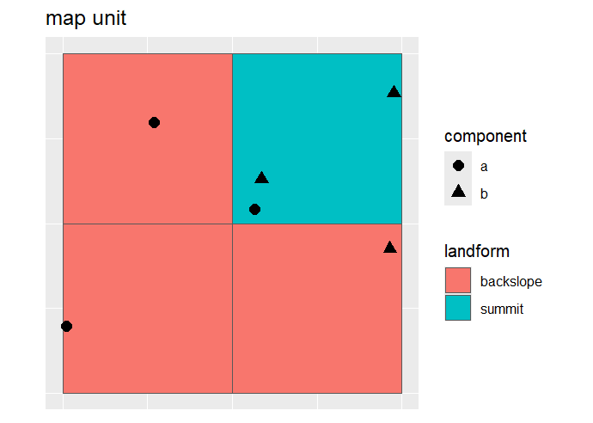
Map Unit Composition - Sampling
table(sample$component)
a component b component
3 3
tabs(w ~ component, data = sample)
a component b component
2.333333 1.666667
 | Component
Map Unit | A | B | User Accuracy / Map Unit Purity
A-B | 58 | 42 | 58

Slide 32
Map Unit Composition – “Modeling”
 |  | Component
Map Unit | Landform | A | B | User Accuracy / Map Unit Purity
A-B | Backslope | 50 | 25 | 58
A-B | Summit | 8 | 17

Slide 33
Map unit Aggregation
Horizons
Segment/Slice Depth Intervals
Component
Aggregate Depth Intervals
Map Unit
Aggregate Component
Weight by Horizon Thickness (cm)
Weight by Component Composition (%)

Slide 34
References
Brubaker SC, Hallmark CT. 1991. A Comparison of Statistical Methods for Evaluating Map Unit Composition. In: Mausbach MJ, Wilding LP, editors. Spatial Variabilities of Soils and Landforms [Internet]. Vol. 28. Madison, WI, USA: Soil Science Society of America; p. 73–88. https://doi.org/10.2136/sssaspecpub28.c6
Hammer RD, Young FJ, Williams F. 1998. Evaluating Central Tendency and Variance of Soil Properties within Map Units. Soil Science Society of America Journal. 62(6):1640–1640. https://doi.org/10.2136/sssaj1998.03615995006200060022x
Jansen IJ, Arnold RW. 1976. Defining Ranges of Soil Characteristics. Soil Science Society of America Journal [Internet]. 40(1):89–92. https://doi.org/10.2136/sssaj1976.03615995004000010025x
Nordt LC, Jacob JS, Wilding LP. 1991. Quantifying Map Unit Composition for Quality Control in Soil Survey. In: Mausbach MJ, Wilding LP, editors. Spatial Variabilities of Soils and Landforms [Internet]. Vol. 28. Madison, WI, USA: Soil Science Society of America; p. 183–197. https://doi.org/10.2136/sssaspecpub28.c11
Young FJ, Hammer RD, Williams F. 1997. Estimation of Map Unit Composition from Transect Data. Soil Science Soc of Amer J [Internet]. 61(3):854–861. https://doi.org/10.2136/sssaj1997.03615995006100030020x
Young FJ, Maatta JM, Hammer RD. 2015. Confidence Intervals for Soil Properties within Map Units. In: Mausbach MJ, Wilding LP, editors. Spatial Variabilities of Soils and Landforms [Internet]. Vol. 28. Madison, WI, USA: Soil Science Society of America; p. 213–229. https://doi.org/10.2136/sssaspecpub28.c13

Slide 35
Additional Reading
Healy, K., 2018. Data Visualization: a practical introduction. Princeton University Press. http://socviz.co/
Helsel, D.R., and R.M. Hirsch, 2002. Statistical Methods in Water Resources Techniques of Water Resources Investigations, Book 4, chapter A3. U.S. Geological Survey. 522 pages. http://pubs.usgs.gov/twri/twri4a3/
Kabacoff R. 2022. R in action: data analysis and graphics with R and Tidyverse. Third edition. Shelter Island, NY: Manning Publications. https://www.manning.com/books/r-in-action-third-edition
Peng, R. D., 2016. Exploratory Data Analysis with R. Leanpub. https://bookdown.org/rdpeng/exdata/
Zimmer S, Powell R, Velásquez I. 2024. Exploring Complex Survey Data Analysis Using R: A Tidy Introduction with {srvyr} and {survey} [Internet]. 1st ed. Boca Raton: Chapman and Hall/CRC. https://tidy-survey-r.github.io/tidy-survey-book/

